Slide 1



A (Very) Brief Introduction to
The Case for FairShares
Feb 2018
Dr Rory Ridley-Duff, Professor of Cooperative Social Entrepreneurship
Sheffield Hallam University
Cliff Southcombe
MD Social Enterprise International Ltd
Contact: r.ridley-duff@shu.ac.uk
Directors
Co-Founders

Slide 2
Sustainable cooperative enterprises
For the last 15 years, a group of staff / consultants linked to Sheffield Business School have worked on developing, researching and disseminating information about social and solidarity enterprises (enterprises with multiple stakeholders) to improve sustainability.
In 2012 - Cliff Southcombe (MD, SEi Ltd), Nicci Dickins (MD, Make It Happen Consultancy Ltd) and Rory Ridley-Duff (Professor, Sheffield Business School) published a discussion document about:
  Sharing wealth and power among primary stakeholders;
  Reviewing ethical choices of which goods/services to offer;
  Reviewing ethical practices in production and retailing;
  Specifying social purpose(s) and audit their social impact(s);
  Advancing social democratic models for ownership / governance / management
In 2015, they registered the FairShares Association Ltd.

Slide 3

FairShares Values and Principles
1. Wealth and power sharing amongst primary stakeholders
Structuring companies, co-operatives, associations and partnerships to advance equality and equity between members, stakeholder groups and trading partners. Wealth created is shared fairly amongst founders, producers, users and investors to promote mutuality and reciprocity.
2. Specification of social purpose(s) and auditing of impact(s)
Empowering members through the constitution to establish and evaluate social value creation (such as specific improvements to their own, their community’s and the wider environment’s health and well-being).
3. Ethical review of the choice of goods/services offered
Encouraging members to think carefully about the well-being that their joint enterprise creates (or could create) through designing and offering products and services.
4. Ethical review of production and retailing processes
Developing products and services using production and retailing processes that positively affect members, society and the environment.
5. Social democratic ownership, governance and management
Extending ownership amongst all primary stakeholders who are directly affected by operations so that they have a clear right to participate in decisions on how the (natural, human, social, intellectual, economic and financial) capital they contribute is managed.
Source: http://www.fairshares.coop/brand-principles/

Slide 4
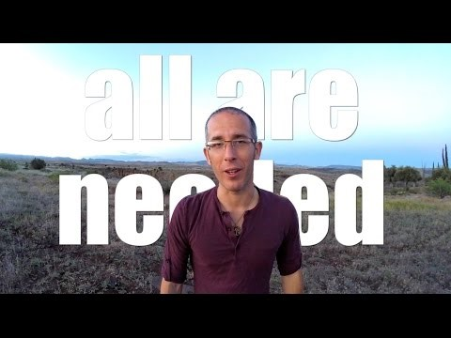
FairShares: A Video Introduction
Rob Jameson (below) and Eric Doriean of Mass Mosaic registered AnyShare Society as a FairShares Company in the USA (January 2016).

Slide 5
Sustainable enterprises: primary stakeholders
Do you structure your organisations to recognise these stakeholders?
Investors
Users
We promote solidarity enterprises that recognise the legitimate interests of these primary stakeholders
Labour
Founders
Are the interests of these stakeholders recognised in theory / practice?

Slide 6
Limitations in private enterprise?
External investors, only enfranchised if risk capital is needed.
Founders acquire
exclusive control
over IP
needed to
generate
wealth
Investors
These
groups
are not recognised as owners of the wealth their mutual interactions create.
Users
Labour
Private enterprises normally exclude labour and users from membership.
Instead they contract with them to secure resources.
Founders
The ‘simple’ private enterprise does not use its constitution to attract labour and users,
and usually requires re-negotiation when investors are involved.

Slide 7
Limitations in charities?
Charitable organisations get money through donations, grants, member subscriptions and other funders to support a beneficiary group.
(Donors / Members)
Users
None of these groups are supposed to profit from the wealth created by stakeholder interactions.
Labour
Founders
Beneficiaries
A charity's constitution is designed to limit wealth sharing.
It is not a vehicle for enriching founders, labour force members or donor-members.

Slide 8
Limitations in single-stakeholder coops?
Users / workers can be encouraged to make some social investments through collective reserves
Investors
Users
...but user / consumer
co-ops limit the power of founders, workers’ and (external) investors.
Workers / producer co-ops limit the power of founders, users and (external) investors.
Users or workers become the main beneficiary of the wealth created by stakeholder interactions...
Labour
Founders
Beneficiaries
A co-operative constitution is an improvement, but in single-stakeholder mode, it is still a limited vehicle for enriching all primary stakeholders.

Slide 9
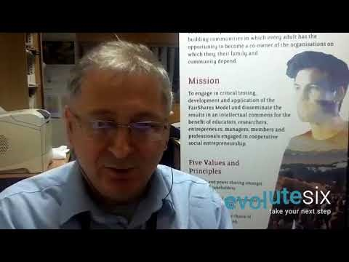
FairShares: Early Adoptions
Professor Rory Ridley-Duff from the FairShares Institute answers a question from Graham Boyd (EvoluteSix founder) about the influence of Mondragon co-ops on early adopters of FairShares Model.

Slide 10
The logics of the FairShares Model
Sustainable co-operative enterprises that are legal persons designed to enfranchise primary stakeholders.
Investors
Users
Every FairShares enterprise recognises founders, labour and/or users as classes of member.
Labour
FairShares
co-operatives and companies can issue shares to recognise financial investors as members.
Founders
FairShares values and principles can be operationalised through
company, co-operative, partnership and association law.

Slide 11
Basic Concepts in the FairShares Model
Consumer Co-operation
Social Entrepreneurship
Worker Co-operation
Founder Shares
User Shares
FairShares Model
Labour Shares
Investor Shares / Accounts
Supporting Institutions
Intellectual Property: managed as an intellectual commons. It is either:
Created in-house: owned by groups of Labour Shareholders, available to all members.
Bought/acquired: owned collectively by Labour Shareholders, available to all members
Labour cannot be alienated from the IP it creates (even when workers leave).
Ridley-Duff R. J. and Bull, M. (2013) The FairShares Model: a communitarian pluralist approach to constituting social enterprises?, paper to ISBE Conference, Cardiff, 11th-12th November, Figure 6

Slide 12
Applying FairShares to Co-op Banking
Account Holders
Co-operative Movement
Bank Staff
Founder Shares
User Shares
FairShares Model
Labour Shares
Investor Shares / Accounts
Co-operatives / Mutuals / Associations / Foundations
Intellectual Property: managed using Creative Commons licences.
Created in-house: owned by groups of bank staff, available to all staff / account holders
Bought/acquired: owned collectively by Labour Shareholders, available to all members.
Based on: Ridley-Duff R. J. and Bull, M. (2013) The FairShares Model: a communitarian pluralist approach to constituting social enterprises?, paper to ISBE Conference, Cardiff, 11th-12th November

Slide 13
Applying FairShares to Public Services
Residents/
Local Businesses
Local Authority
/ Trade Union
Local Authority
Staff
Founder Members
User Members
FairShares Model
Labour Members
Investor Shares / Accounts
Public Bodies, Social / Ethical Investors
Intellectual Property: managed using Creative Commons licences.
Created in-house: owned by groups of staff, available to local residents / businesses.
Bought/acquired: owned collectively by Labour Shareholders, available to all members.
Based on: Ridley-Duff R. J. and Bull, M. (2013) The FairShares Model: a communitarian pluralist approach to constituting social enterprises?, paper to ISBE Conference, Cardiff, 11th-12th November

Slide 14
Applying FairShares to Food Chains
Consumer Members
Marketing Co-operative or
Charitable Trust
Producer Members
Founder Shares
User Shares
FairShares Model
Labour Shares
Investor Shares / Accounts
Credit unions, social / ethical investors
Intellectual Property: managed using Creative Commons licences.
Created in-house: owned by groups of producers and consumers.
Bought/acquired: owned collectively by Labour Shareholders, available to all members.
Based on: Ridley-Duff R. J. and Bull, M. (2013) The FairShares Model: a communitarian pluralist approach to constituting social enterprises?, paper to ISBE Conference, Cardiff, 11th-12th November

Slide 15
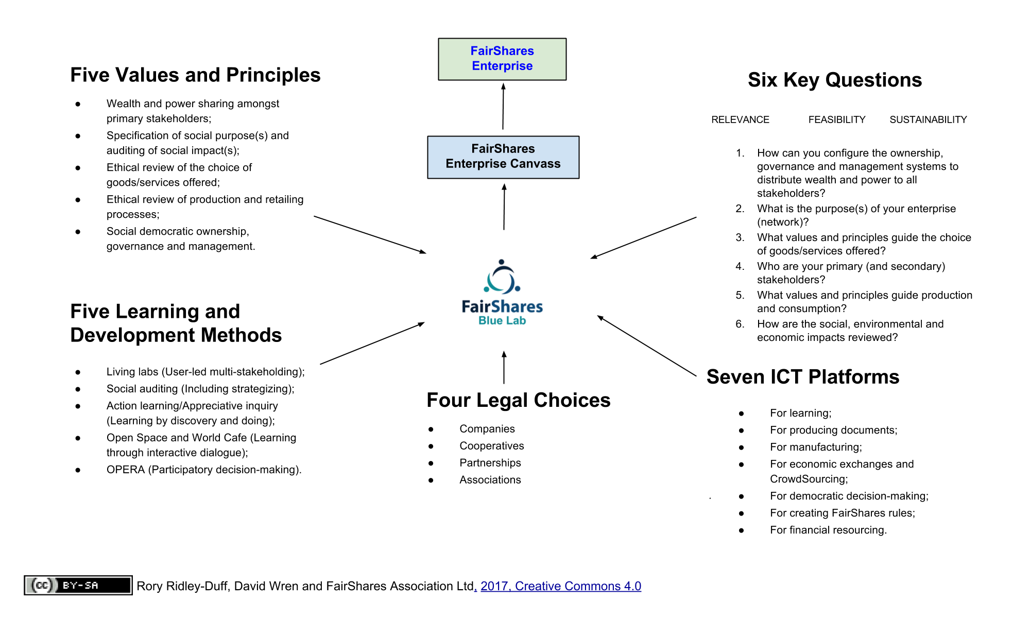
Developing a FairShares Lab

Slide 16
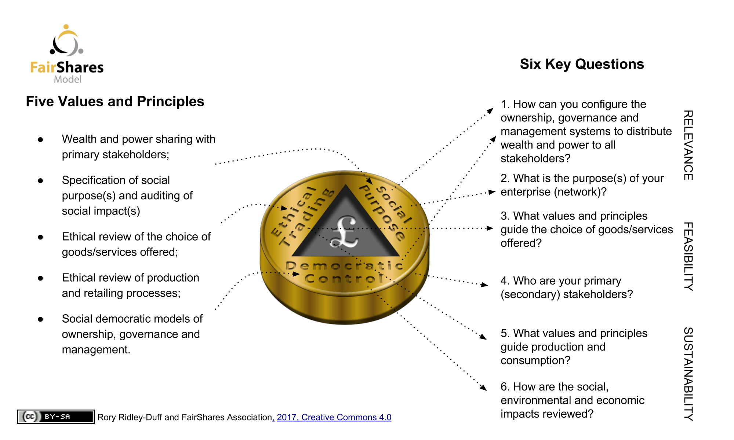
Developing a FairShares Lab

Slide 17
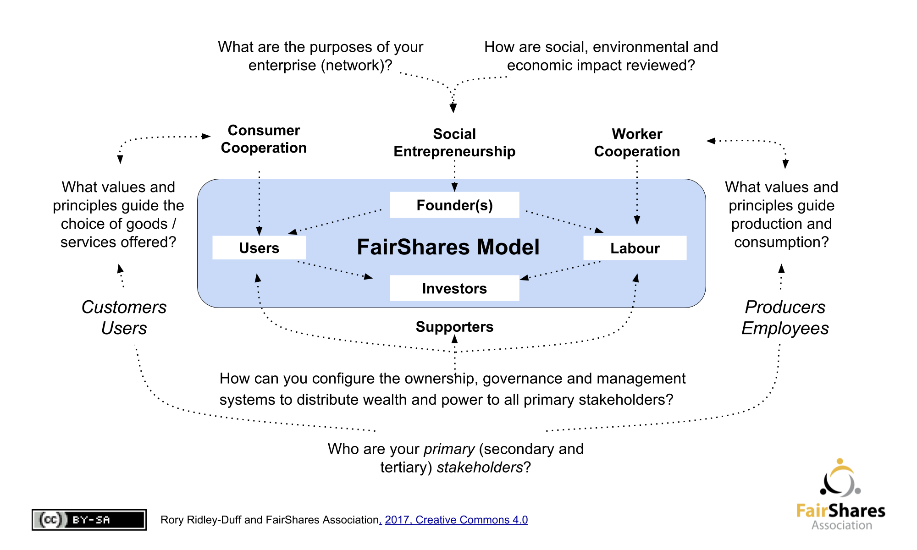
Developing a FairShares Lab

Slide 18
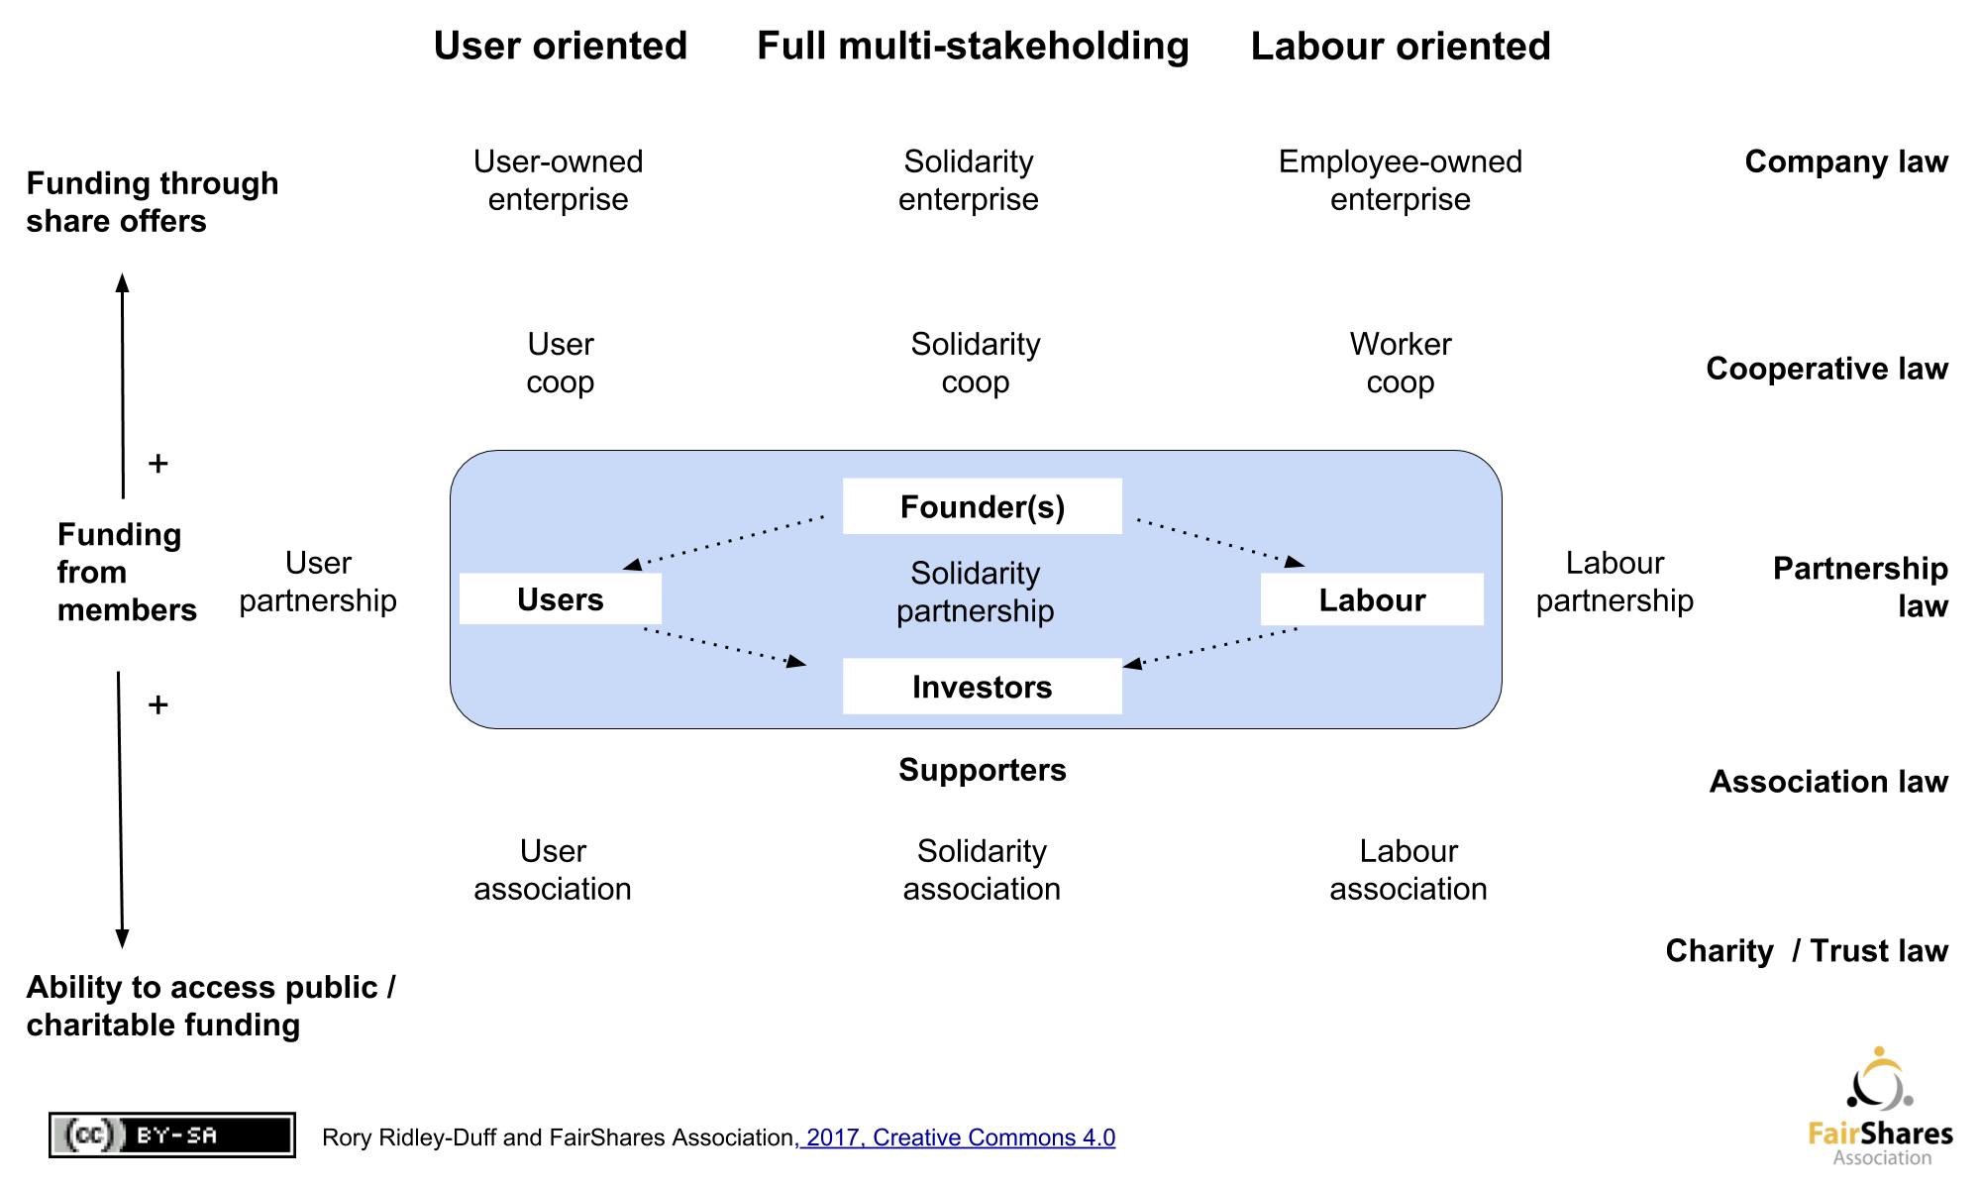
Developing a FairShares Lab

Slide 19
FairShares and Sustainability
Group | United Nations - Sustainable Development Goals
Addressing Poverty and Inequality | 1, 2, 5, 10 | FairShares Value & Principle 1 Wealth and power sharing amongst primary stakeholders Changing the structure of companies, co-ops, associations and partnerships to advance equality and equity between members FairShares Value & Principle 5 Social democratic ownership, governance and management Extending ownership / control to all primary stakeholders
Improving the Quality of Work and Life | 3, 4, 8, 16
Managing the Environment | 6, 7, 13, 14, 15 | FairShares Value & Principle 2 Specification of social purpose(s) and auditing of impact(s) Establishing and evaluating social value creation FairShares Value & Principle 4 Ethical review of production and retailing processes Production and retailing processes that positively affect members, society and the environment
Managing the Economy Sustainably | 9, 11, 12, 17 | FairShares Value & Principle 3 Ethical review of the choice of goods/services offered Well-being created by good product / service design

Slide 20
Resources
FairShares Community: https://fairshares.loomio.org
FairShares Association: www.fairshares.coop
FairShares Labs: www.fairshareslab.org
FairShares Institute: www.fsi.coop
FairShares Institute Courses: www.fsi.coop/courses
Technical Support: www.fairshares.coop/wiki
FairShares Novel: The Dragons’ Apprentice
FairShares Book: The Case for FairShares
Academic Conference Paper(s), Academic Journal Article(s), Learning and Teaching Materials

